Slide 1
Becoming
(Geo)Scientist
Email: jyotirmoyp@iisc.ac.in
Find me: https://jyotirmoyp.github.io
or http://ceas.iisc.ernet.in/~jyotirmoy/
Twitter: @JyoGeoPhy
Jyotirmoy Paul
Centre for Earth Sciences
Indian Institute of Science

Slide 2
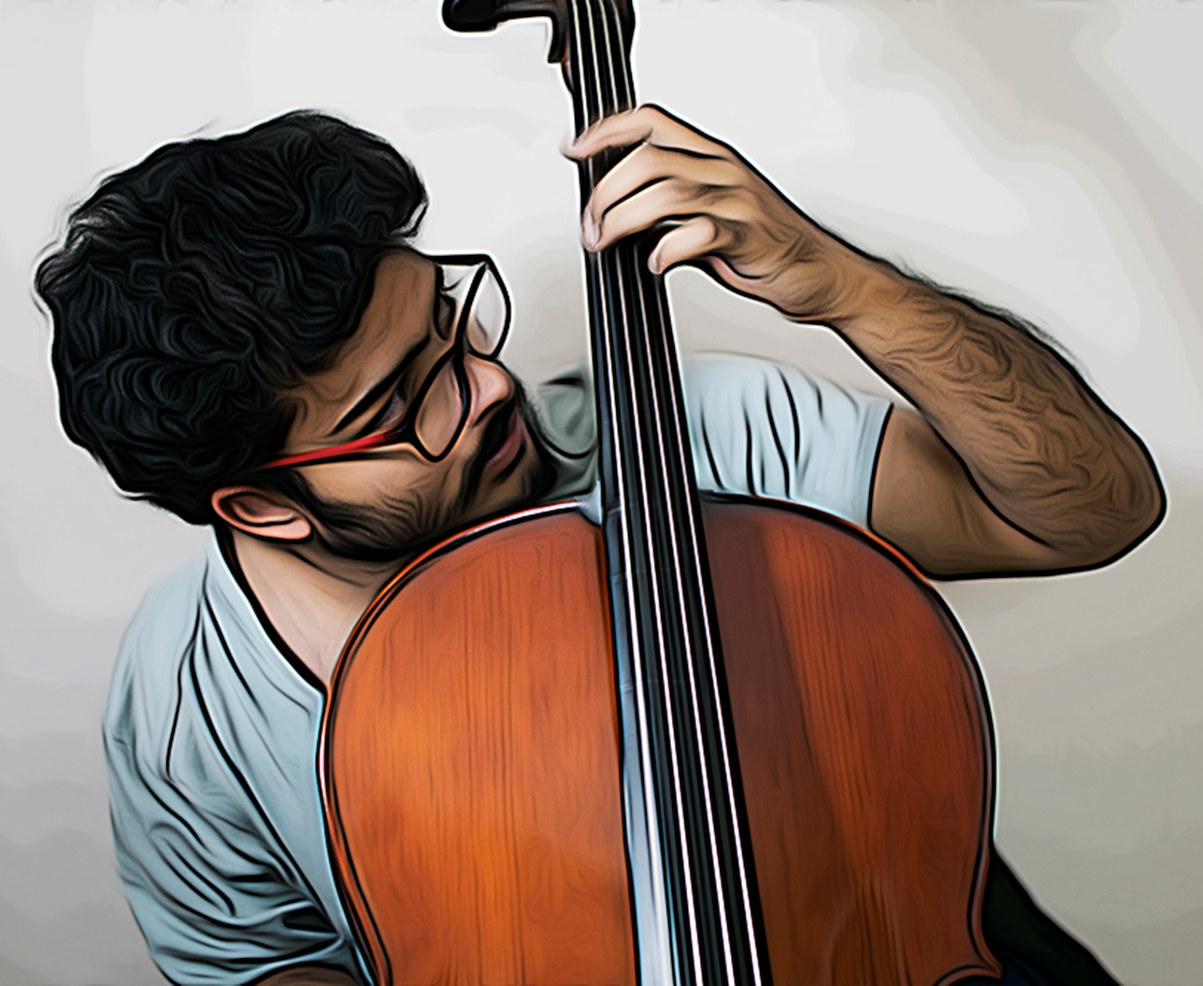
Who am I?
Pursuing PhD in Geodynamics at IISc
Develop numerical models of Earth
Music, Read, Travel
JU Years: 2010 - 2015
Notes:
My introduction

Slide 3
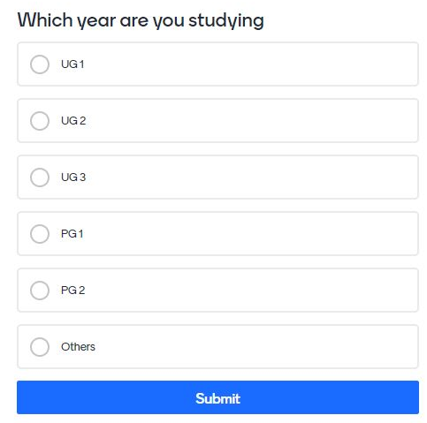

Break the ice!
https://www.menti.com/d9mx5x3mai
Notes:
Audience intro

Slide 4
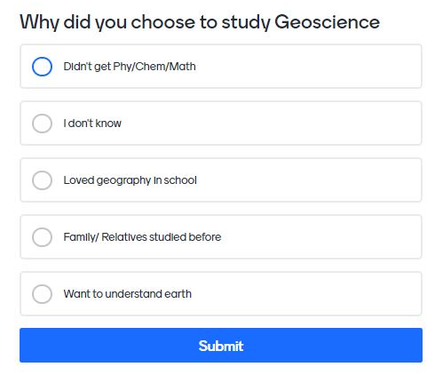
Break the ice!
https://www.menti.com/d9mx5x3mai
Notes:
Ice breaker

Slide 5
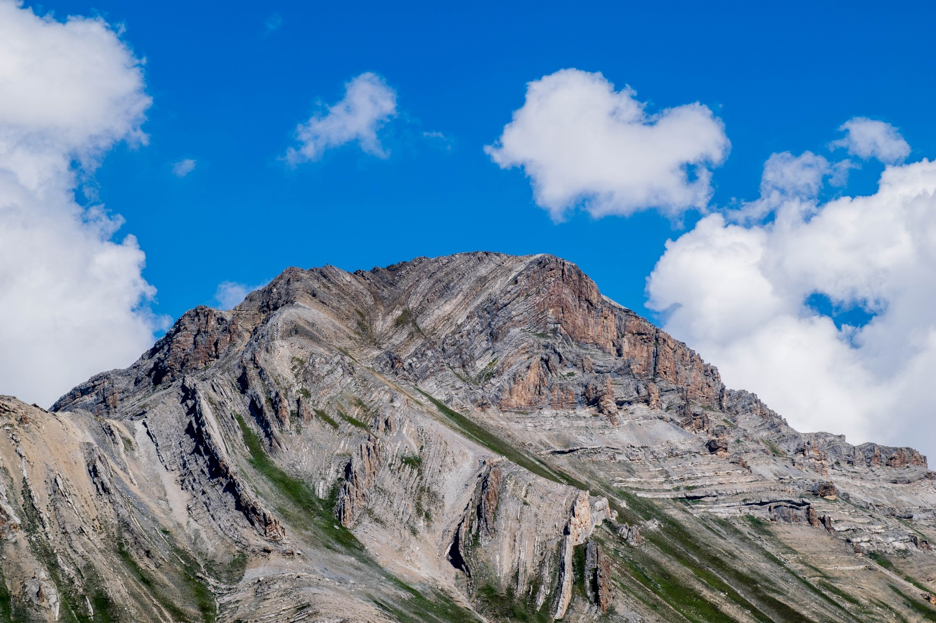
My influence
Beautiful nature
Love for mountain
How did they form?
Notes:
Why I came here

Slide 6
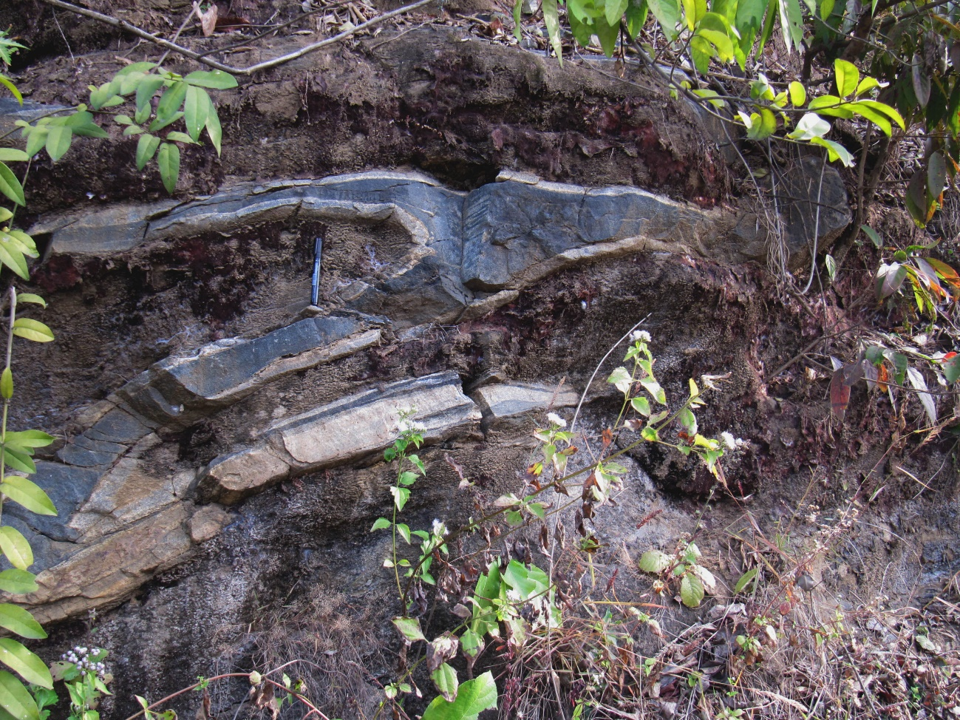
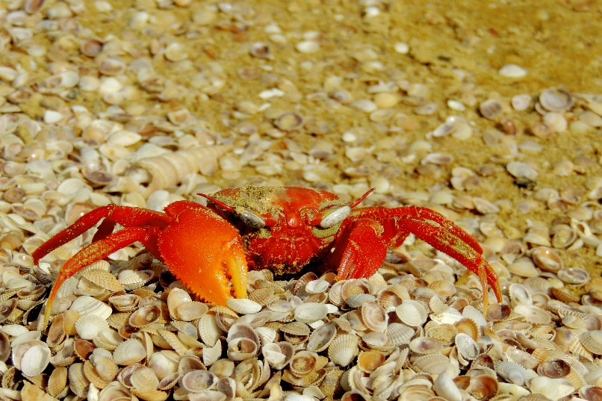
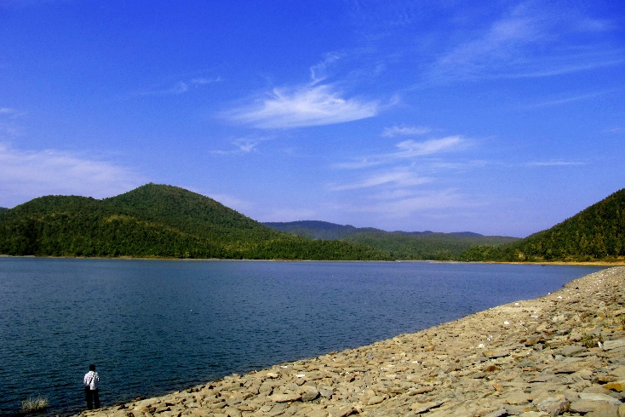
And the Journey begins…
Notes:
Brief talk on JU Journey. Most of the branches will be introduced in JU. What is your favourite branch still now?

Slide 7
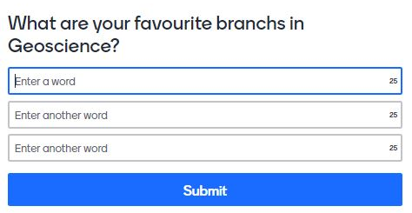

Geo-xxxxxx?
https://www.menti.com/rfy5b8ip6q
Notes:
survey

Slide 8
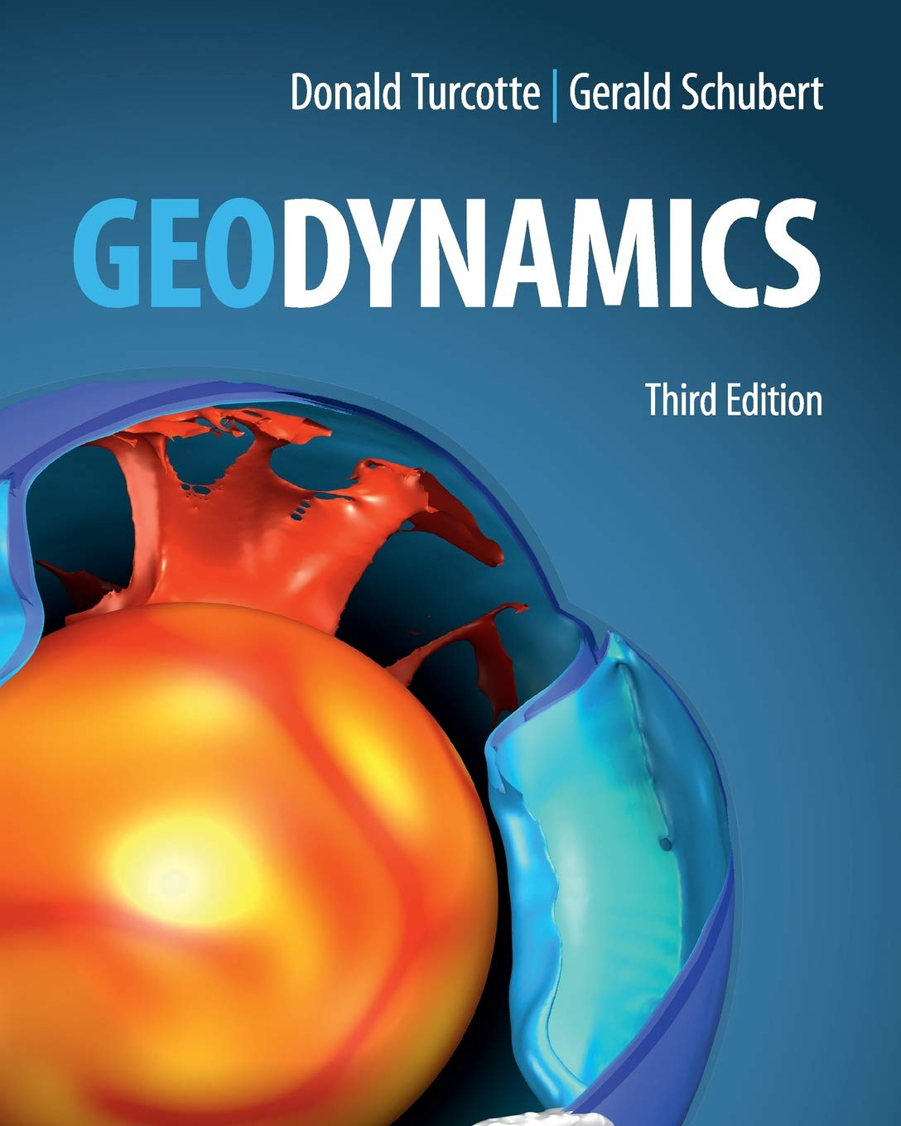
Geodynamics
Dynamics: Relationship between force and motion (Also force in equilibrium)
Geodynamics: Dynamics of Earth (Mantle has a hegemony here)
Why?
Crust : Geology
Core: Magneto-Hydrodynamics (MHD)
Notes:
I work on mantle convection models and plate tectonics. How plate tectonics have influenced mantle convection and when did it start. These questions have influenced me to choose geodynamics as research subject.

Slide 9

Into the modeling world
A scientific model is a physical and/or mathematical and/or conceptual representation of a system of ideas, events or processes.
All models are beautiful!
Notes:
Modeling is a popular word now. I told I do modelling. But what is modelling?

Slide 10
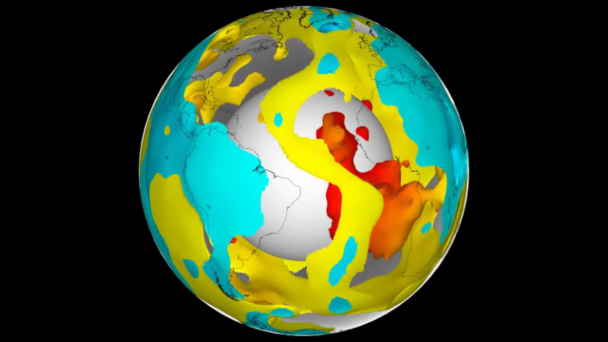
Why Geodynamicists model?
Time scale of natural process: Real time experiment is impossible
Number of variables/ unknown in natural system
Non-intuitive nature of physical properties
Non-linear nature of governing equations
Notes:
Why do we need it?

Slide 11
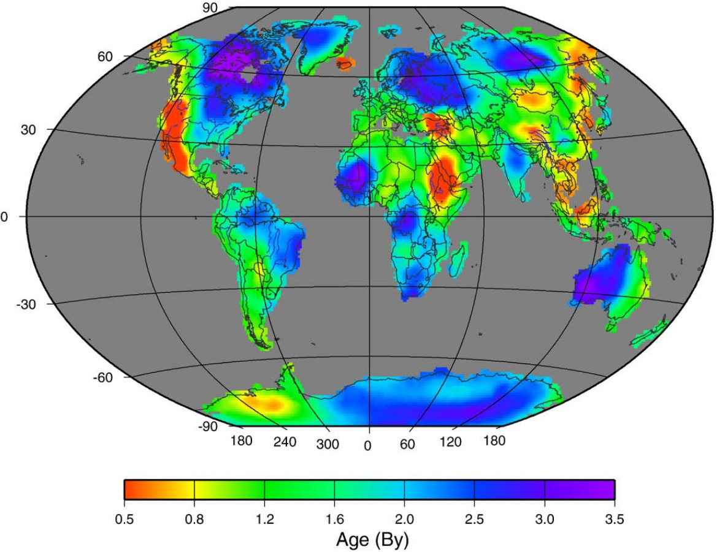
My Present Work
Why cratons are still here?
One of the grand challenges in Geodynamics (Olson et al. 2010)
(Poupinet and Shiparo, 2008, Lithos)
Notes:
My models

Slide 12
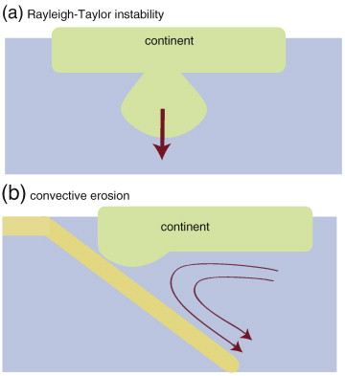
How do continents destroy?
Hypothesis for craton survival:
Cratons are lighter in density
What about convective erosion?
(Karato 2010)

Slide 13
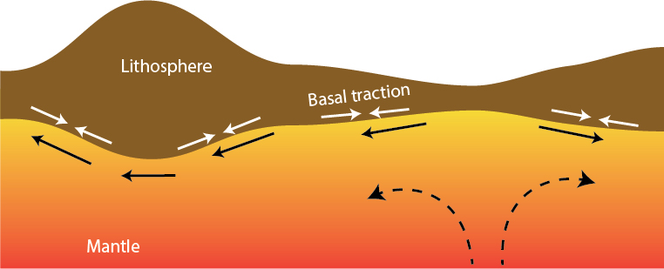
Convective erosion

Slide 14
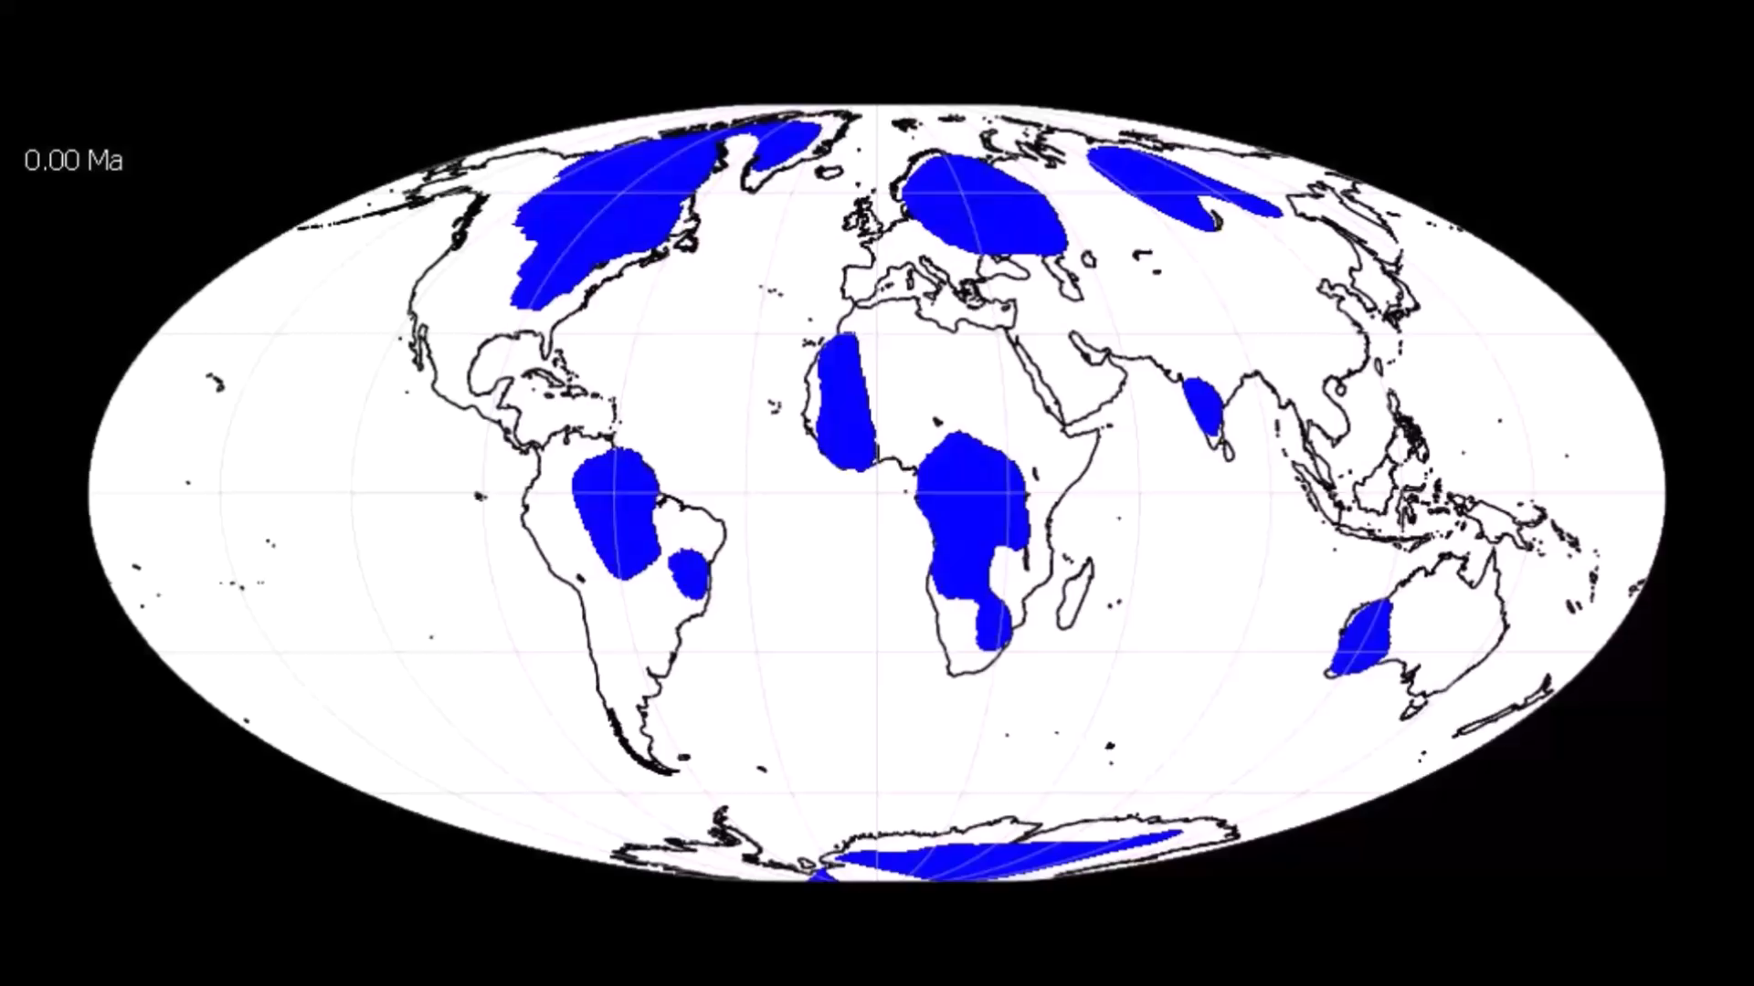
Cratons: Now and then

Slide 15
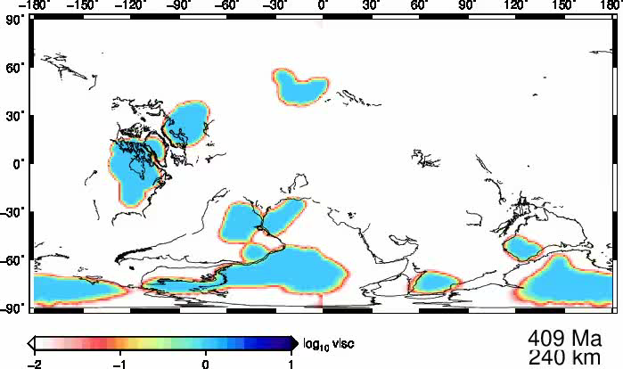

Modeling evolution of cratons
(Paul and Ghosh, 2020, EPSL)

Slide 16
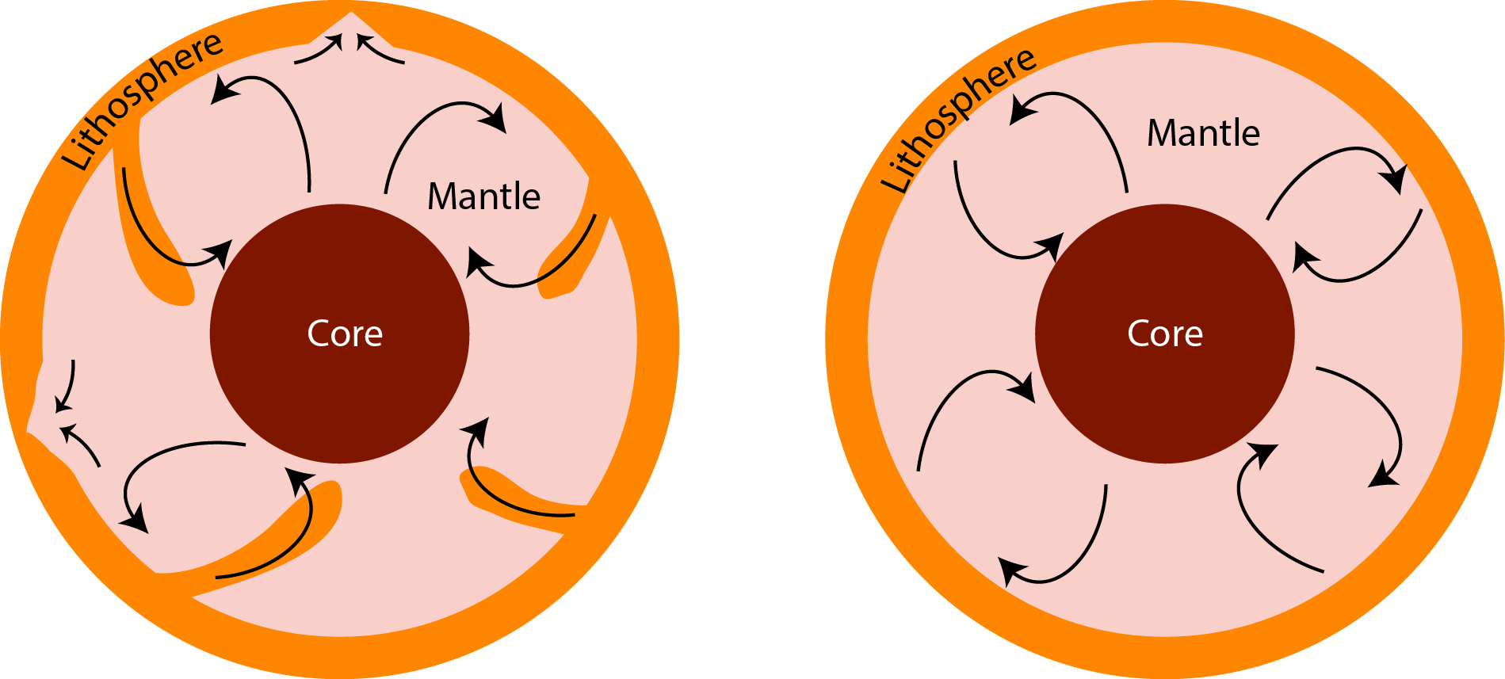
Digging deeper into the time
Transition of tectonic regime ~ 3 Ga?
Origin of plate-tectonics and stabilization of cratons are closely related?
Stagnant-lid and Mobile-lid (Plate-tectonics)
Notes:
Why studying cratons?

Slide 17

Interest
Curiosity
Imagination
Re-Search
Notes:
What about research? Why we research? I am curious about evolution but not interested to get the pain of understanding it.

Slide 18
May not Join a PhD, if
01
Will prepare for jobs in these years!
Of course you have a right enrol to a PhD program anytime,
but doing PhD is not an enrolment
02
Will prepare for jobs in these years!
03
Lots of money after PhD is over!
Notes:
Personal thoughts.

Slide 19
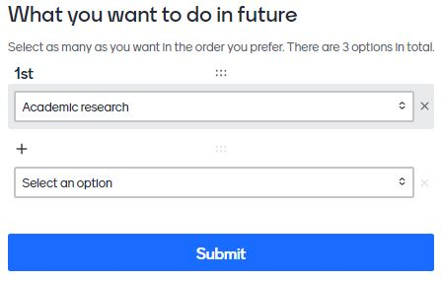

Where are you better fitted?
https://www.menti.com/a86uezqgvr
Notes:
Survey

Slide 20
Academic nomads
India or Abroad?
Notes:
If people are interested to do research.

Slide 21
Disclaimer! All pros and myths can not be generalised. They do vary from case to cases.
Pros
Indian PhD
Family
Can’t Travel/ enjoy life
Root to culture
Indian PhD
Takes eternal
Understanding the system
Poor science
Myths

Slide 22
Disclaimer! All cons and myths can not be generalised. They do vary from case to cases.
PhD in abroad
Cons
Mental Health
Lot of Money
Abroad
Supercool advisors
Racism
Adjusting to Indian system later
Quality PhD
Myths

Slide 23
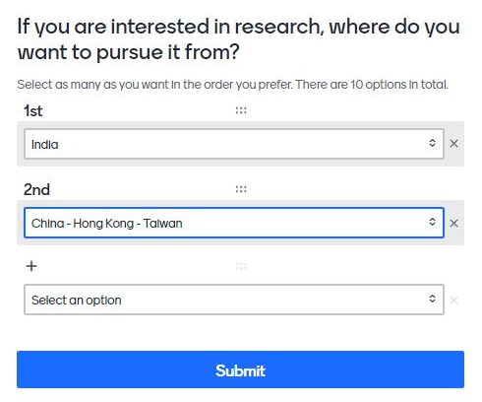
What do you think?
https://www.menti.com/a86uezqgvr
Notes:
survey

Slide 24
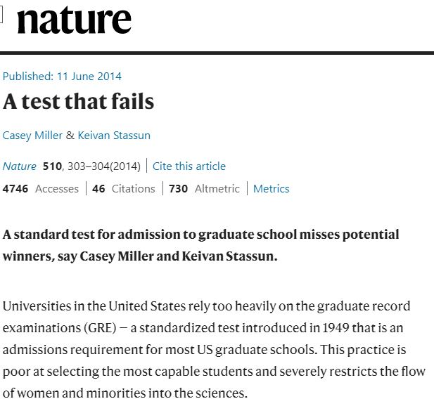
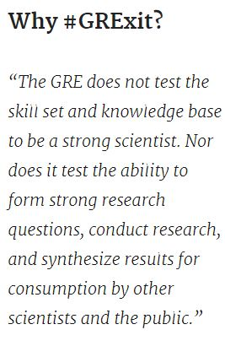
#GeoGRExit
Sense of superiority still remains.
When I told the same, people laughed,
Now Americans are telling
So, people are accepting.

Slide 25

Networking
Write
Science blogs
AGU EOS
EGU Blogs
Notes:
Does not matter where ever you research, do networking. One of the paths to become a better scientist. Interaction, new thoughts. Open up.

Slide 26
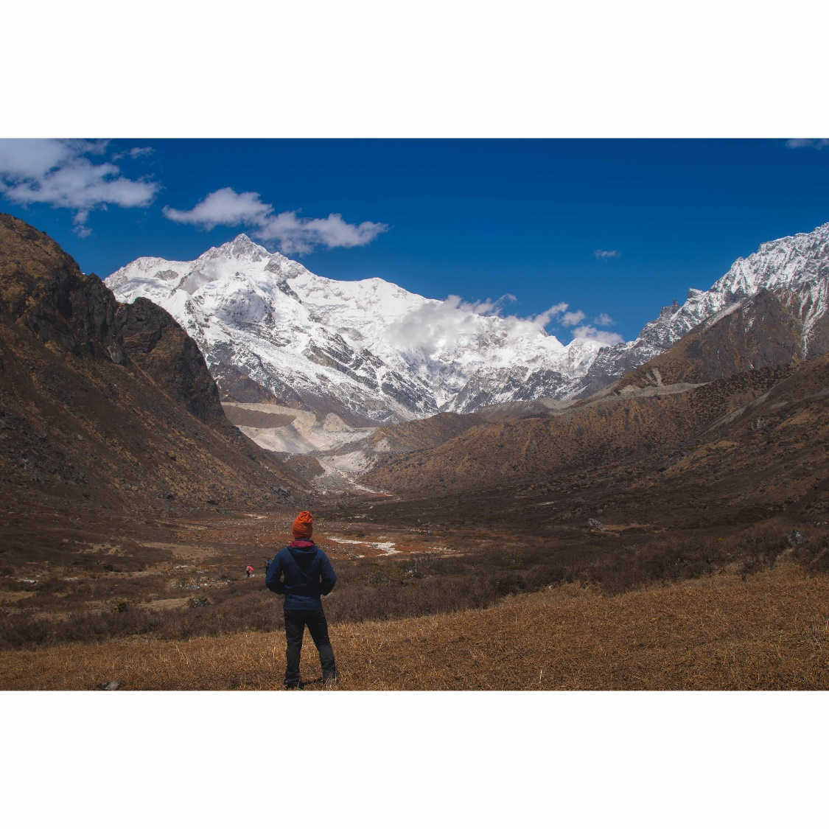
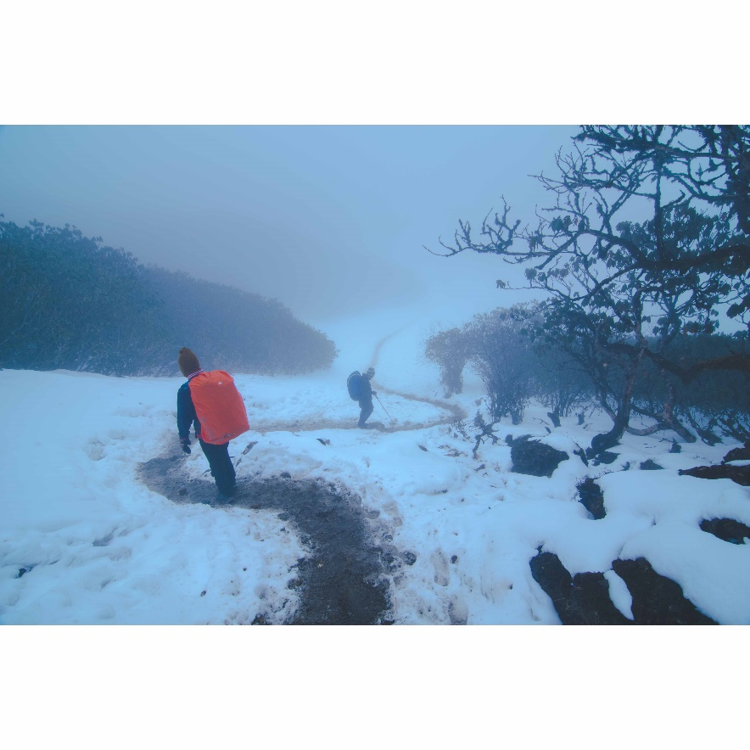
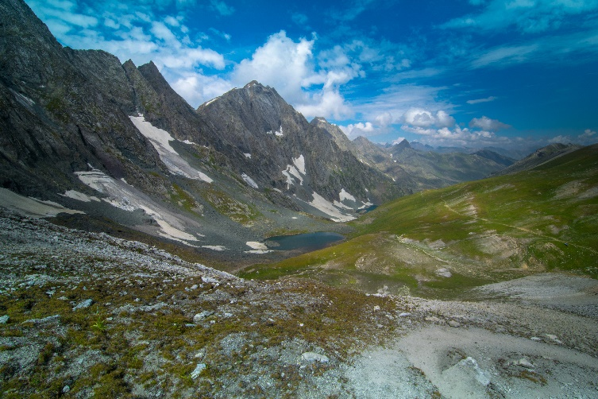
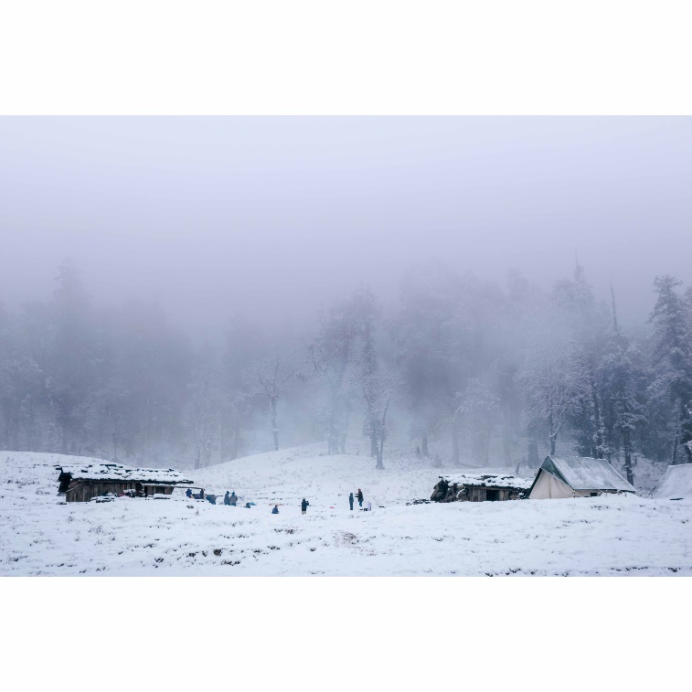
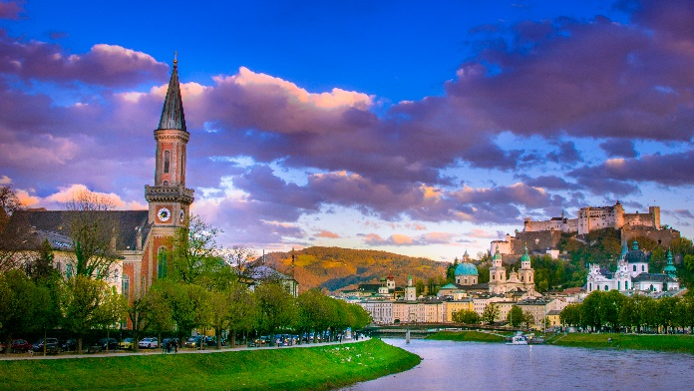
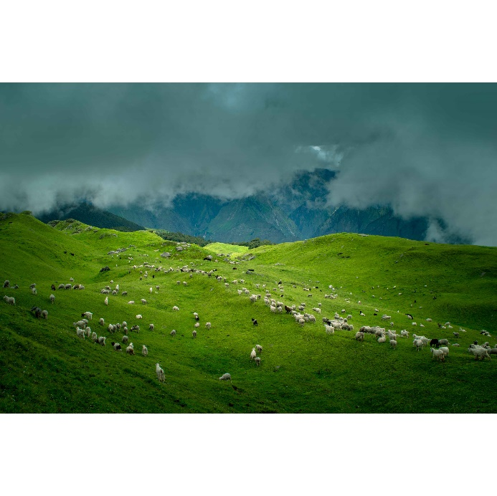
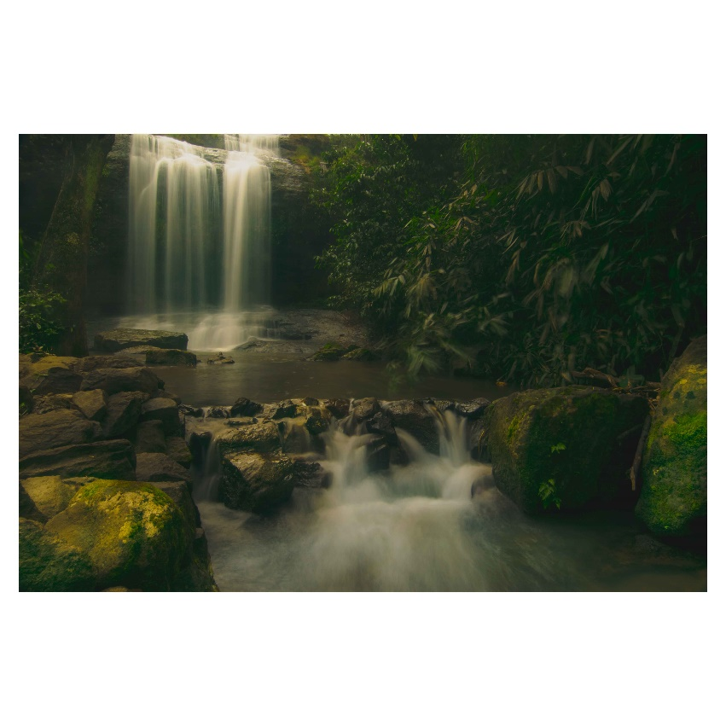
Travel log
Notes:
And travel. Travel across the country to know the people, life style, nature. India is no way worse than Eu countries in terms of travel places.

Slide 27
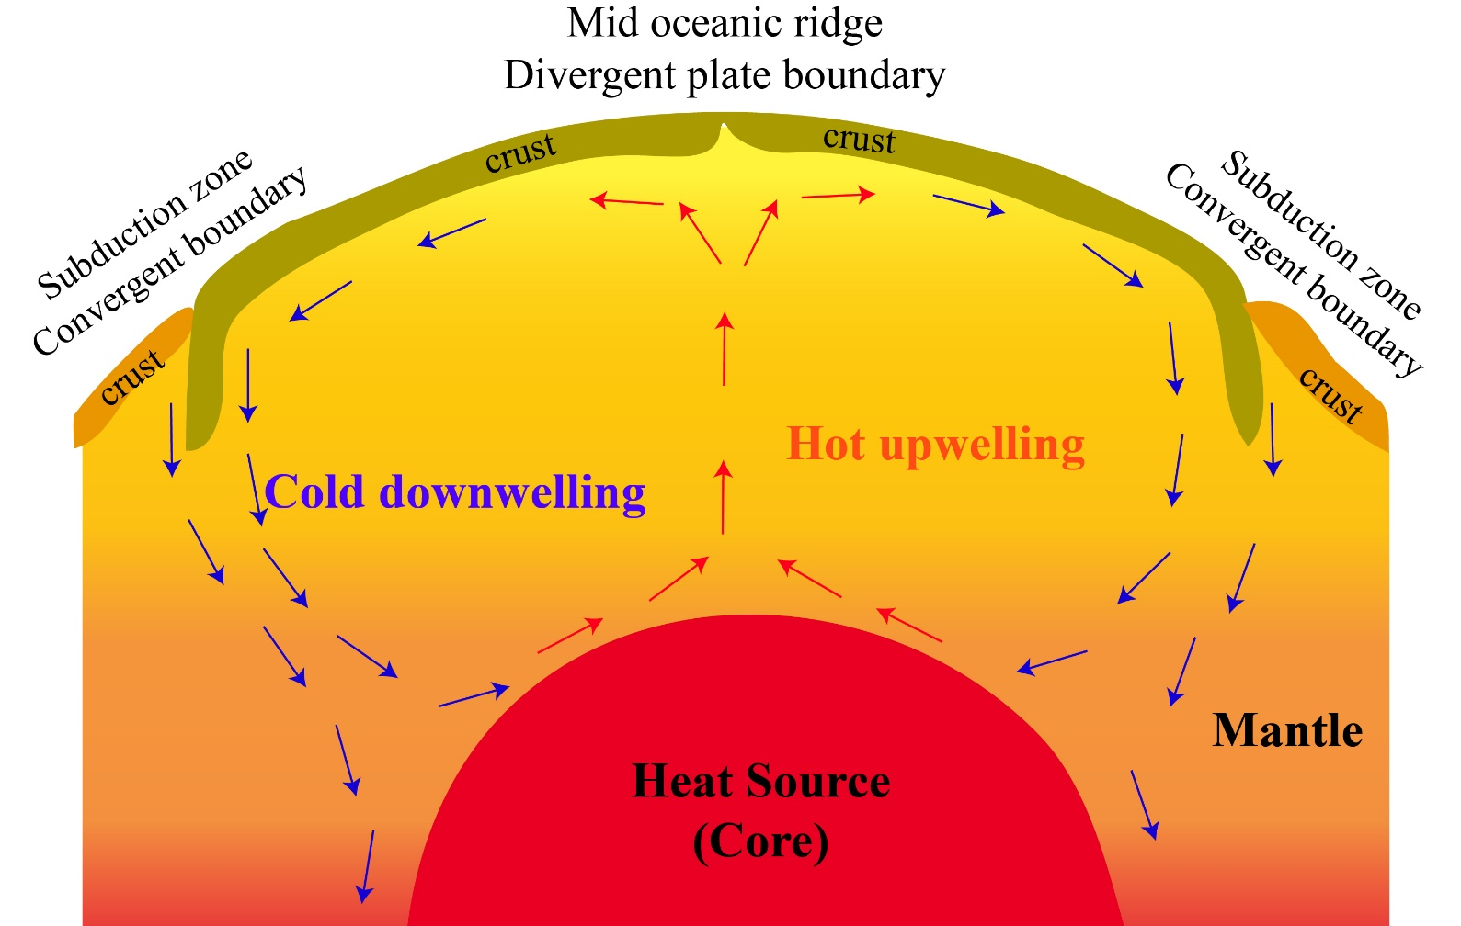
Food for Thought
Does this figure correctly demonstrate mantle convection?
Let me know!
Notes:
End with some food for thought.

Slide 28
State of mantle?
https://www.menti.com/rfy5b8ip6q

Slide 29
